Slide 1
Cloud Deployment Model

Slide 2
Introduction
Clouds can be classified in terms of who owns and manages the cloud; Types of Cloud (Deployment Model)
Public Clouds,
Private Clouds,
Hybrid Clouds
Community Clouds

Slide 3
Public Cloud
A public cloud, or external cloud, is the most common form of cloud computing, in which services are made available to the general public in a pay-as-you-go manner.
Customers – individual users or enterprises – access these services over the internet from a third-party provider who may share computing resources with many customers.
The public cloud model is widely accepted and adopted by many enterprises because the leading public cloud vendors as Amazon, Microsoft and Google, have equipped their infrastructure with a vast amount of data centers, enabling users to freely scale and shrink their rented resources with low cost and little management burden.

Slide 4
Continue…
Security and data governance are the main concern with this approach.

Slide 5
Public Cloud
A public cloud refers to a cloud service delivery model in which a service provider makes massively scalable IT resources, such as CPU and storage capacities, or software applications, available to the general public over the Internet.
Public cloud services are typically offered on a usage-based model.
Public cloud is the first deployment model of cloud services to enter the IT industry’s vocabulary.
The concept of public clouds has clearly demonstrated the long-term potential of the cloud computing model and lit up the imagination of the industry and the research community.

Slide 6
Continue…
While the public cloud offers a clean, infrastructure-less model for end users to consume IT services, and intrigues the research community with its disruptive nature, migrating the majority of today’s IT services, such as the various business applications in an enterprise environment (e.g. insurance applications, health care administration, bank customer account management, the list goes on and on), to a public cloud model is not feasible.
Data security, corporate governance, regulatory compliance, and performance and reliability concerns prohibit such IT applications to be moved out of the “controlled domains” (i.e. within the corporate firewalls), while the public cloud infrastructure, government regulation, and public acceptation continue to improve.

Slide 7
Continue…
There are many public cloud service providers in place today, offering services ranging from infrastructure-as-as-service, to development-platform-as-a-service, to special purpose application-as-a-services.
Amazon EC2, Force.com, and Google App Engine, are among some of the best known examples of public clouds,

Slide 8
Public Cloud Again…
In simple terms, public cloud services are characterized as being available to clients from a third party service provider via the Internet.
The term “public” does not always mean free, even though it can be free or fairly inexpensive to use.
A public cloud does not mean that a user’s data is publically visible; public cloud vendors typically provide an access control mechanism for their users.
Public clouds provide an elastic, cost effective means to deploy solutions.

Slide 9
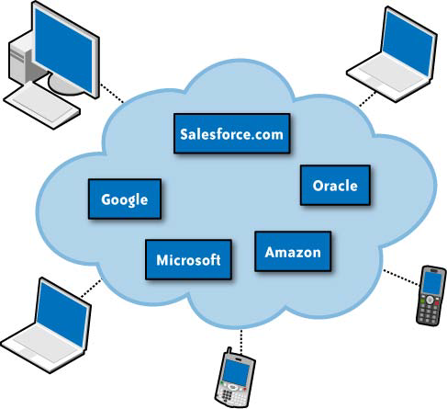
Public Cloud

Slide 10
Reasons for Starting with a Public Cloud
Low Cost:
Public clouds offer a very low cost of entry into cloud computing, which supports pilot project with limited research and development (R&D) funding.
Cloud Solution Variety:
There is a wide variety of cloud enabled resources to assemble into complete cloud solutions, from virtualization and cloud operating system (OS) or platform technologies, to Platforms as a Service (PaaS) and Software as a Service (SaaS) offerings.

Slide 11
Continue…
Low Risk:
An organization can quickly experiment with cloud computing solutions with minimal risk exposure.
Pay for What You Need/Use.
Public clouds are based on a completely variable, utility cost model, whereby once the initial project has completed, or if you no longer need the cloud services, you can stop paying the fees.
Rapid Accumulation of Knowledge, Skills, and Experience.
Public clouds offer a way to quickly gain experience, knowledge, and skills on the emerging technology trend of cloud computing.

Slide 12
Continue…
Leveraging public clouds enables your organization to tap into the knowledge and experience of your third party cloud service provider.
This is a tremendous competitive advantage for any organization seeking first-mover advantage for its cloud computing strategy.

Slide 13
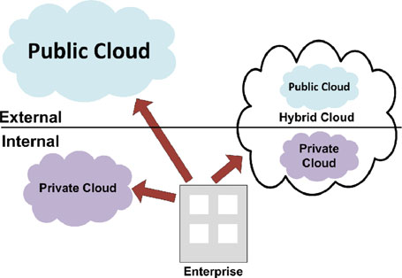
Continue…

Slide 14
Private Cloud
A Private Cloud, or internal cloud, is used when the cloud infrastructure, proprietary network or data center, is operated solely for a business or organization, and serves customers within the business fire-wall.
Most of the private clouds are large company or government departments who prefer to keep their data in a more controlled and secure environment.

Slide 15
Private Cloud
A private cloud offers many of the benefits of a public cloud computing environment, such as being elastic and service based.
The difference between a private cloud and a public cloud is that in a private cloud-based service, data and processes are managed within the organization without the restrictions of network bandwidth, security exposures and legal requirements that using public cloud services might entail.
In addition, private cloud services offer the provider and the user greater control of the cloud infrastructure, improving security and resiliency because user access and the networks used are restricted and designated.

Slide 16
Private Cloud…
Private cloud, in contrast, represents a deployment model where enterprises (typically large corporations with multi-location presence) offer cloud services over the corporate network (can be a virtual private network) to its own internal users behind a firewall-protected environment .
Recent advances in virtualization and data center consolidation have allowed corporate network and datacenter administrators to effectively become service providers that meet the needs of their customers within these corporations.

Slide 17
Continue…
Private clouds allow large corporations to benefit from the “resource pooling” concept associated with cloud computing and their very own size, yet in the mean time addressing the concerns on data security, corporate governance, government regulation, performance, and reliability issues associated with public clouds today.
Critics of private clouds point out that these corporations “still have to buy, build, and manage clouds” and as such do not benefit from lower up-front capital costs and less hands-on management, essentially “lacking the economic model that makes cloud computing such an intriguing concept.”

Slide 18
Continue…
While these criticisms are true from a purist’s point view, private clouds are a viable and necessary deployment model in the overall adoption of cloud computing as a new IT model.
We believe that without large corporations embracing it, cloud computing will never become a main stream computing and IT paradigm.
Private cloud represents an enabling as well as a transitional step towards the broader adoption of IT services in public clouds.

Slide 19
Reasons for Starting with a Private Cloud
Security and Privacy.
Mitigates privacy and security concerns by maintaining data behind your own firewalls.
Strategic Opacity.
Maintains strategic dullness, so your competitors cannot ascertain your intentions.
Focus on Internal Optimization First.
Internally optimize internal utilization of infrastructure assets.

Slide 20
Continue…
Become an Internal Cloud Service Provider.
Beginning your cloud strategy with a private cloud focus will accelerate your ability to become an internal cloud service provider to the enterprise.
This is a key benefit of beginning your cloud initiative internally with a private Cloud Deployment Model.

Slide 21
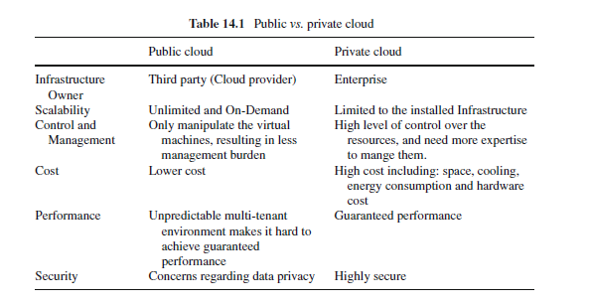

Slide 22
Hybrid Cloud
A composition of the two types (private and public) is called a Hybrid Cloud, where a private cloud is able to maintain high services availability by scaling up their system with externally provisioned resources from a public cloud when there are rapid workload fluctuations or hardware failures.
In the Hybrid cloud, an enterprise can keep their critical data and applications within their firewall, while hosting the less critical ones on a public cloud.

Slide 23
Hybrid Cloud
While public and private clouds represent the two ends of the cloud computing spectrum in terms of ownership and efficiency of shared resources – and each is finding acceptance in accordance to the services offered and customer segments targeted – a third deployment model of cloud computing, the hybrid cloud model that blends the characteristics of public and private clouds, is emerging.
A hybrid cloud is a deployment model for cloud services where an organization provides cloud services and manages some supporting resources in-house and has others provided externally.

Slide 24
Continue…
For example, an organization might store customer data within its own data center and have a public cloud service, such as Amazon’s EC2, to provide the computing power in an on-demand manner when data processing is needed.
Another example is the concept of “public cloud as an overflow for private clouds” where an IT manager does not need to provision its enterprise private cloud for the worst-case workload scenario (doing so will certainly defeat the economics of a private cloud), but to leverage a public cloud for overflow capacities to move less-mission-critical workloads on and off premise dynamically and transparently to accommodate business growth or seasonal peak load demands.

Slide 25
Community Cloud
The idea of a Community Cloud is derived from the Grid Computing and Volunteer Computing paradigms.
In a community cloud, several enterprises with similar requirement can share their infrastructures, thus increasing their scale while sharing the cost.
Another form of community cloud may be established by creating a virtual data center from virtual machines instances deployed on underutilized users machines

Slide 26
Community Cloud
A community cloud is controlled and used by a group of organizations that have shared interests, such as specific security requirements or a common mission.
The members of the community share access to the data and applications in the cloud.

Slide 27
Hybrid Cloud
A hybrid cloud is a combination of a public and private cloud that interoperates.
In this model users typically outsource non business- critical information and processing to the public cloud, while keeping business-critical services and data in their control.

Slide 28
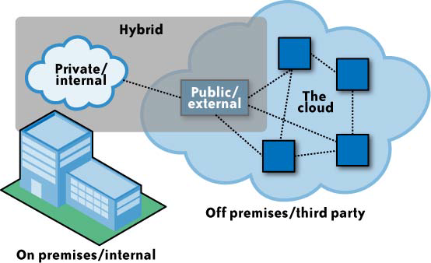
Hybrid Cloud

Slide 29
Assignment(s)
Find the reason for using hybrid cloud
Design proper Cloud Deployment model in KU.

Slide 30
Any question???

